Slide 1
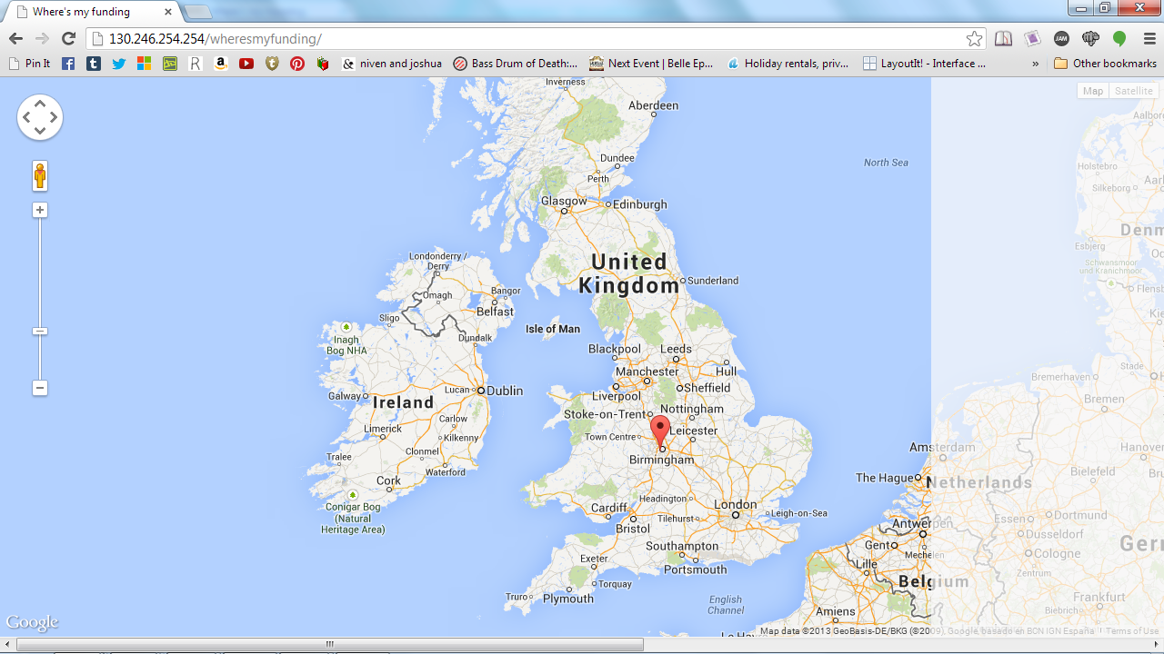
Show me the £unding
Callum Williams, Imogen Richards, Aneeqa Munir, Matt Reggler
STFC Rutherford Appleton Laboratory Centre,
Earth
Notes:
Introduce ourselves and our centre, introduce project

Slide 2
What is it?
A web app allowing the user to view on a map where research projects relating their specified search query are taking place.
A Functionality allowing to see dispersion of funding
Notes:
Using data from the UK Research Council Website API, we have created a web application that creates a visually focused display of data based on a specified user inputted search query. The user is able to see where research projects related to their search are taking place on a map, and look into them further through info windows giving details of projects taking place at particular research centres.
A button on the website allows the user to view blobs in proportion to the amount of funding going to particular institutions on research projects related to the search term. This allows the user to view instantaneously how money (from the 7 publicly funded research councils) is split over the country and where grants are being award to- letting the user easily view if their is a concentration of funding in particular areas or institutions.

Slide 3
How it works?
Using the UK Reasearch Council API
Using Python 3, and outputting it as JSON
Webserver interprets
Notes:
How our project does it: back end json & API etc. Small explanation
Using Python 3, our script extracts all the data from the UK Research Council API about a specific search term. It does this by taking the identifiers of each of the projects and using the API again to extract the project name’s, funding value etc. of each project and outputting it as one JSON file, which is then interpreted by the web server.

Slide 4
Geolocation
Using the UK postcodes.com API, the python interacts to translate the postcodes into lat-long coordinates to use in the google maps in our websites display
Notes:
Google maps api, postcodes LAT LONG explination

Slide 5
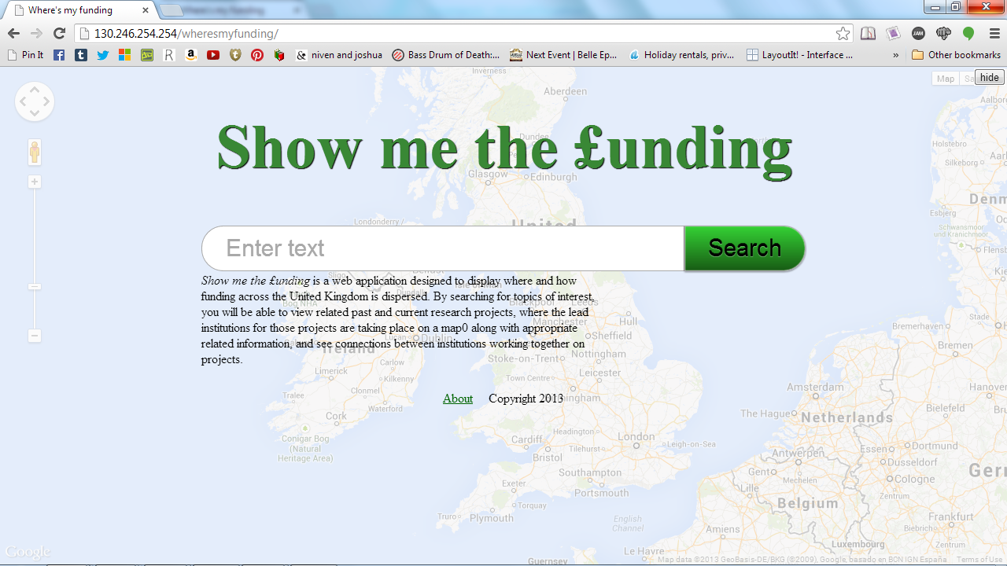
Notes:
website demonstration BASICALLY EXPLAINS WHAT HAPPENS WHEN YOU DO WHAT

Slide 6
Who? Why?
People going to Universities, or looking for Post Graduate training
Researchers and those interested in the actual research being done, and where.
The general population who want to know where publically funded bodies are awarding grants in subjects they are interested in
Notes:
Why this is useful who is it useful to:
TARGET AUDIENCE:
- young people may be interested in our project so they can see
the sorts of research going on in the universities they might want to apply to.
a lot of universties give oppurtunities in their reserach separments to students as extra-ciric
and might be interesting in general pre-application. one of the UKRC functions is to support post grad students training.
-the general population may want to know where money is being given to:
research funding is provided by three main sectors; corporations/ the private sector who are usually motivated by potential profit,
and a small amount from charitable institutions. GTR is only about the 7 publicly funded information.
-people interested in the actual research being done; what institutions are getting research grants in the topic/search criteria you're interested in and who is funding them
is funding them quite an interesting thing for maybe a research scientist to be looking at.

Slide 7
Future Functionality
Connections between institutions
Statistical analysis of the funded amount (£)
SQL database of every possible search to increase speed
Notes:
what it lead on to /// future/// future functionality.

Slide 8

Thank you!
Notes:
Thank you????? RAL, MENTORS, JUDGES, YRS

